Slide 1
CNENGR 228
Digital Electronics
Lecture 6 – VHDL Fundamentals 3
Dr Zhongming Zhang
School of Engineering
Lancaster University

Slide 2
Course Outline
  VHDL Design Units
  Library
  Entity
  Architecture
  Structural
  Behavioral
Sequential
Signal Assignment
Concurent
Signal Assignment

Slide 3
Objectives
  After completion of this lecture you will
  Behavioral vs Structural description of architecutre
  VHDL Statements-Sequential signal assignment
  Testbench simulation
3

Slide 4
Structural Description
Top-level module: the module that has not been used in other circuits
Design hierarchy: a design can use multiple sub-modules or a module multiple times
Top-level module
M1
M2
Inputs
M3
M1
M1
Outputs
low-level
modules
M2
M1
4

Slide 5
Using Sub-circuits
Top-level module
Example
  Component Declaration
  Component Instantiation
    Using a module in another top-level.
    Label to identify unique instance of component.
    Component type to select the desired declared component.
    Port map to connect ports of components of sub-modules to that of top-level design.
c
n1
x
h
f
F
x
F
x
F
p
y
n2
y
OR2
Inv
AND2
Top-level module
Inv_1
c
n1
h
f
p
n2
AND2_1
OR2_1

Slide 6
Component Declaration
  To declare the Port types and the Data Types of the ports for a lower-level design a component construct is used.
component Inv
port ( x : in std_logic;
F : out std_logic);
end component;
x
F
Inv
Top-level module
Inv_1
c
component <lower-level_design_name>
port (
<port name>: <mode> <data type> ;
<port name>: <mode> <data type>
);
end component
n1
h
f
p
n2
6

Slide 7
Component Instantiation
Inv_1
c
n1
h
f
x
Inv
F
p
n2
label
Output of NOT gate on Inv
(low-level port)
Inv_1: Inv port map (x => c, F => n1);
n1: internal signal
in the parent architecture
component type
<instance>: <component>
port map (
<port> => <parent signal or port>,
<port> => <parent signal or port>);
7

Slide 8
Design Hierarchy
Library ieee;
use ieee.std_logic_1164.all;
entity DoorOpener is
port ( c, h, p: in std_logic;
f: out std_logic);
end entity DoorOpener;
Door Opener
Inv_1
c
n1
h
f
architecture circuit of DoorOpener is
begin
end architecture circuit;
p
n2
component declaration
OR2_1
AND2_1
signal n1, n2 : std_logic;
component instantiation
8

Slide 9
Design Hierarchy
Component declaration
component Inv
port ( x : in std_logic;
F : out std_logic);
end component;
component OR2
port ( x, y : in std_logic;
F : out std_logic);
end component;
component AND2
port ( x, y : in std_logic;
F : out std_logic);
end component;
Component Instantiation
Inv_1: Inv port map (x => c, F => n1);
OR2_1: OR2 port map (x => h, y => p, F => n2);
AND2_1: AND2 port map (x => n1, y => n2, F => f);
Door Opener
Inv_1
c
n1
h
f
p
n2
OR2_1
AND2_1
9

Slide 10
Design Hierarchy
  This component-based approach uses component declarations and component instantiations
DoorOpener.vhd
Entity-Architecture “top-level”
Component “Inv”
Component “OR2”
Component “AND2”
Inv.vhd
entity-architecture “Inv”
OR2.vhd
entity-architecture “OR2”
AND2.vhd
entity-architecture “AND2”
10

Slide 11
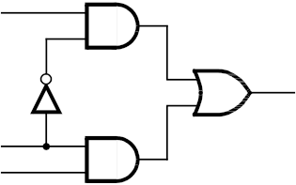
Practical 3-Exercise 2 (behavioral description)
Practical 5a-Exercise 1 (structural description)
s
  Implement a 2-to-1 multiplexer with a select input
x
s
n₁
n₃
m
x
m
y
s
y
n₂
  (Behavioral Description)
  (Structural description)
m <= (NOT (s) AND x) OR (s AND y);
11

Slide 12
Sequential Statements
  Here, sequential statements are used inside a process
  They are evaluated in the order in which they appear in the code (sequential) and describe the behaviour
process (sensitivity_list)
Constant declarations
Variable declarations
begin
- sequential assignments;
- if-else statements;
- case statements
- loop, while, for statements
end process;
Local objects
Sequential statements
  A “process” block contains one or more sequential statements and sequential assignments
12

Slide 13
Sequential Statements
Library
Library
Entity
Entity
Architecture
Architecture
process (a, b, c)
begin
c <= a and b;
y <= c;
end process;
  Process is sensitive to sensitivity list
process(all)
begin
c <= a and b;
y <= c;
end process;
  A sensitivity list identifies signals whose events resume the process.
  For combinational logic, include every signal read, including conditions.
  VHDL-2008: process(all) includes all signals read. A plain process does not.

Slide 14
Wait Statements
  Timed waits model testbench delays. Supported clock-edge waits can describe synthesizable registers.
  Three types
  wait for <time_ expression>: pauses until time specified by the expression has elapsed.
  wait on <signal>: pauses until signal event occurs.
  wait until: resumes on a signal event when the condition is true.
    wait for 20 ns;
    wait on a;
    wait until (int < 100);
    wait on a for 5 us;

Slide 15
Process block: Quick Notes
  Sensitivity list implies a wait statement at the end of the process
  A process repeats; a wait or sensitivity list suspends it until it can resume.
  Process can not have both a sensitivity list and wait statement.
  Concurrent signal assignments represent implied processes operating in parallel
proc1 : process (a,b)
begin
Sequential statements;
end process;
proc2 : process
begin
Sequential statements;
wait on a, b;
end process;

Slide 16
Sequential Statements
Sequential Statements
Loop
statements
Sequential assignments
Case
statements
If-then
statements
Simple signal assignment
Variable
assignment
process (sensitivity_list)
begin
- sequential assignments;
- if-else statements;
- case statements
- loop, while, for statements
end process;
Sequential statements

Slide 17
Sequential assignment
Sequential Statements
Sequential assignments
Loop
statements
If-then
statements
Case
statements
Simple signal assignment
Variable
assignment
  Variable assignment denoted by :=
    Executes sequentially; the variable updates immediately.
  Signal assignment denoted by <=
    Executes sequentially and schedules an update. With no explicit delay, the signal updates in a later delta cycle after suspension.

Slide 18
Sequential assignment
One activation: trigger changes from 0 to 1; initial s_var = s_sig = 2.
signal trigger : bit := '0'; -- before architecture begin
Variable assignment
Signal assignment
process(trigger)
variable s_var : integer := 2;
variable a_var : integer := 0;
begin
if trigger = '1' then
s_var := 4;
a_var := s_var;
end if;
end process;
-- before architecture begin:
signal s_sig : integer := 2;
signal a_sig : integer := 0;
-- after architecture begin:
process(trigger)
begin
if trigger = '1' then
s_sig <= 4;
a_sig <= s_sig;
end if;
end process;
s_var = 4, a_var = 4
s_sig = 4, a_sig = 2
Variables update immediately.
The second statement reads the new value.
Results shown after scheduled updates.
The second statement reads the current value.

Slide 19
Overall Code Parallelism
  Statements inside a process block are evaluated sequentially.
  However, all process blocks are evaluated concurrently.
  All concurrent signal assignments are evaluated concurrently too.
  Example: a <= ‘0’; b <= ‘0’;
c <= a xor b;
d
process (a , c)
begin
d <= a and c;
end process
e
a
c
process (c, d)
begin
e <= (not(d) and c) or (d and not(c));
end process
b

Slide 20
Practical 5b- VHDL Testbench
  Assigns values to a system's inputs, check that system outputs correct values
  A key use of HDLs is to simulate system to ensure design is correct
Testbench
System To Test
Set input values, Check output values
23

Slide 21
Practical 5b- VHDL Testbench
Architecture
  Entity of Testbench
  No inputs or outputs
  Architecture of Testbench
  Declares component to test, declares signals.
  Instantiates component, connects to signals.
  Process writes input signals, checks output signal.
Circuit
Under Test
Process
System
To Test
Set input values, Check output values
Entity-Testbench
24

Slide 22
Summary
  Familiarity with structural description of architecture
  Introducing the concept of process in VHDL
  Introducing the Testbench for simulation of circuits

Slide 23
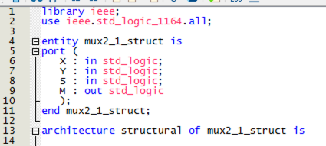
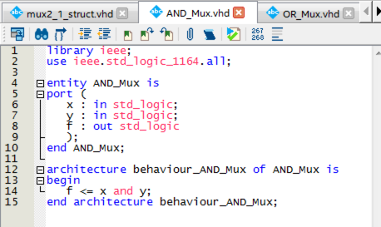
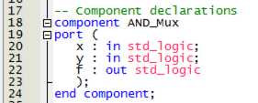

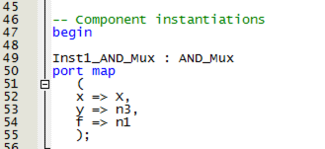
Hints for Practical 5a-Exercise 1
s
x
m
y
x
m
s
y

Slide 24
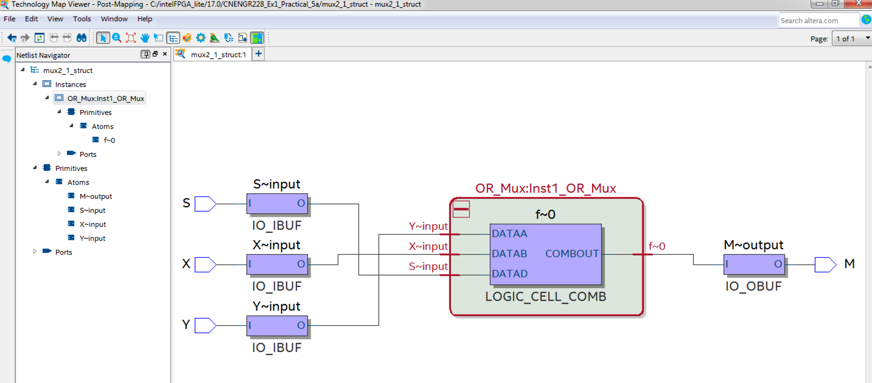
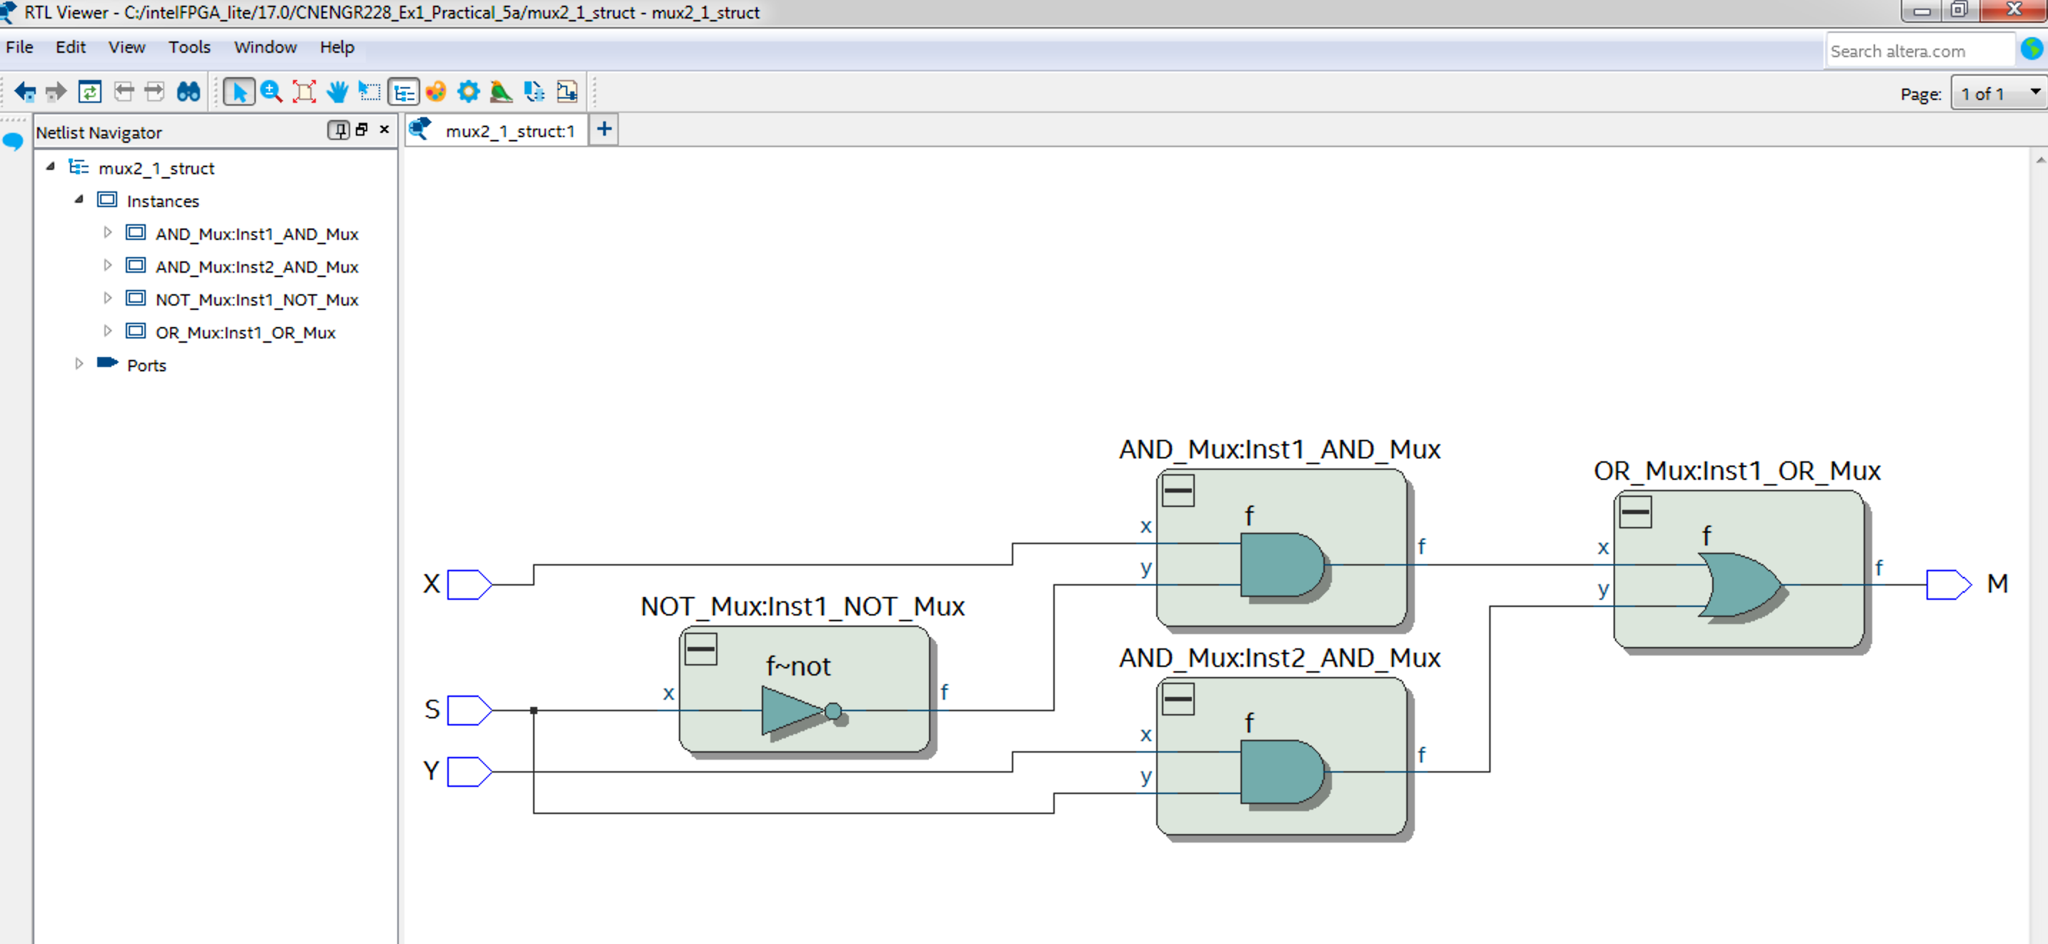
Hints for Practical 5a-Exercise 1
Netlist Viewers -> RTL Viewer
Netlist Viewers -> Technology Map Viewer (Post-Mapping)

Slide 25
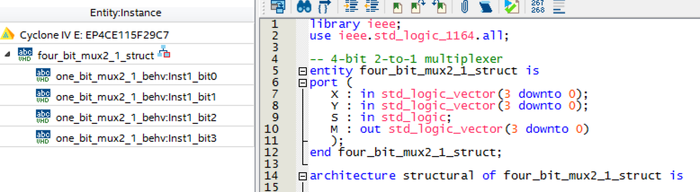
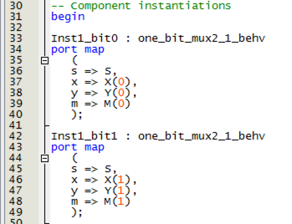
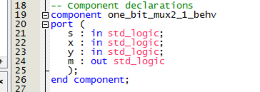
Hints for Practical 5a-Exercise 2

Slide 26
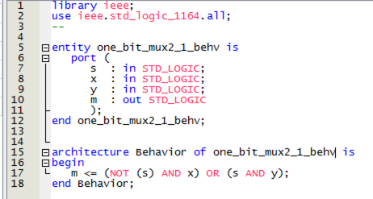
Hints for Practical 5a-Exercise 2

Slide 27
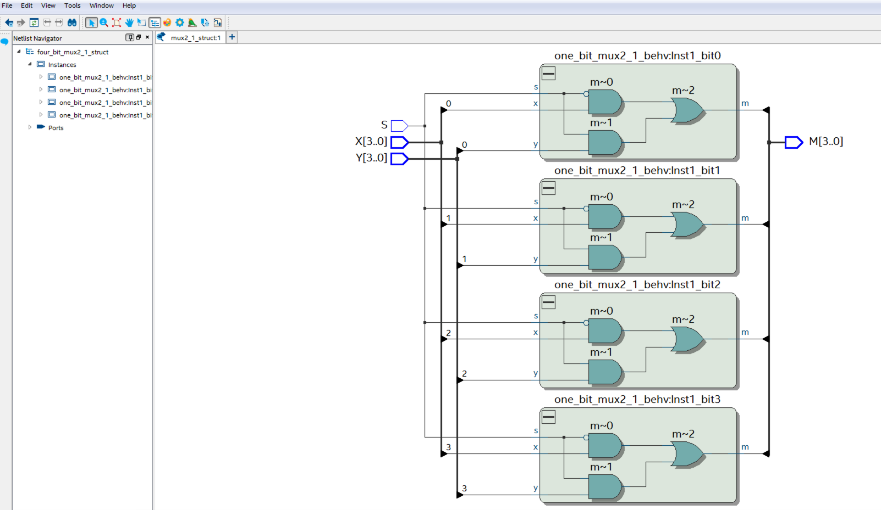
Hints for Practical 5a-Exercise 2

Slide 28
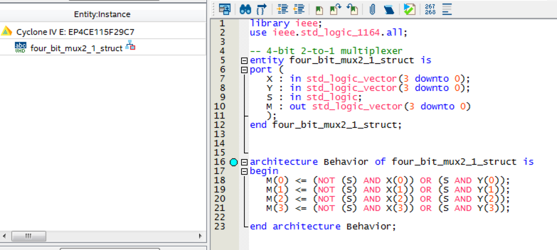
Hints for Practical 5a-Exercise 2
(defined using “simple signal assignment”)

Slide 29
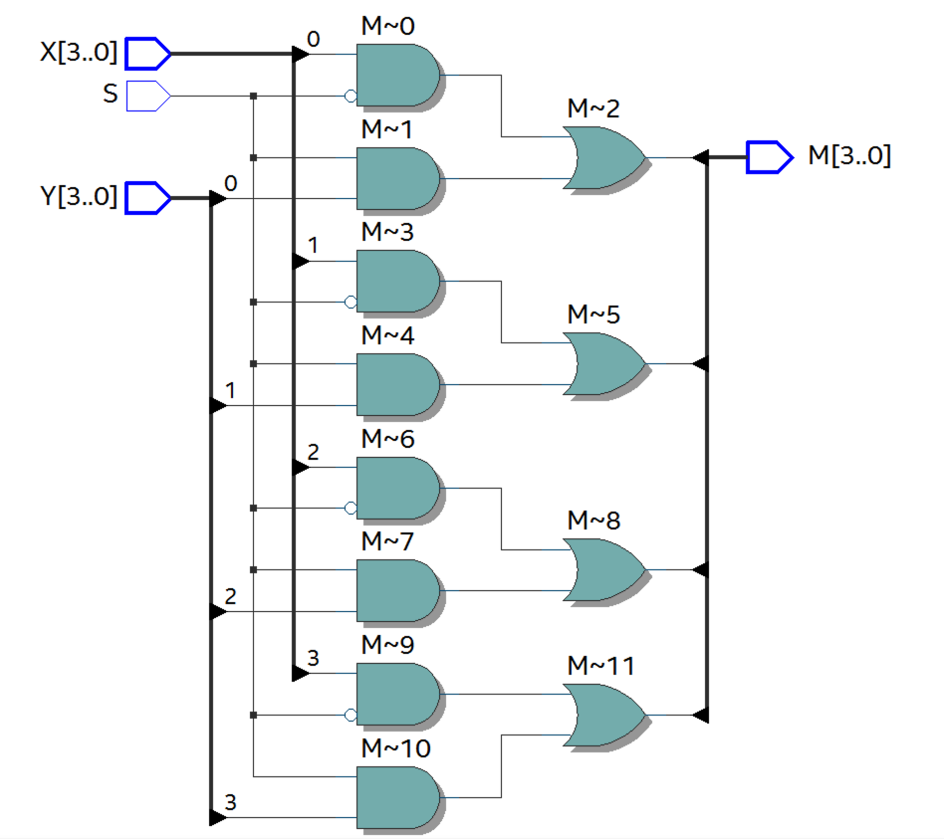
Hints for Practical 5a-Exercise 2

Slide 30

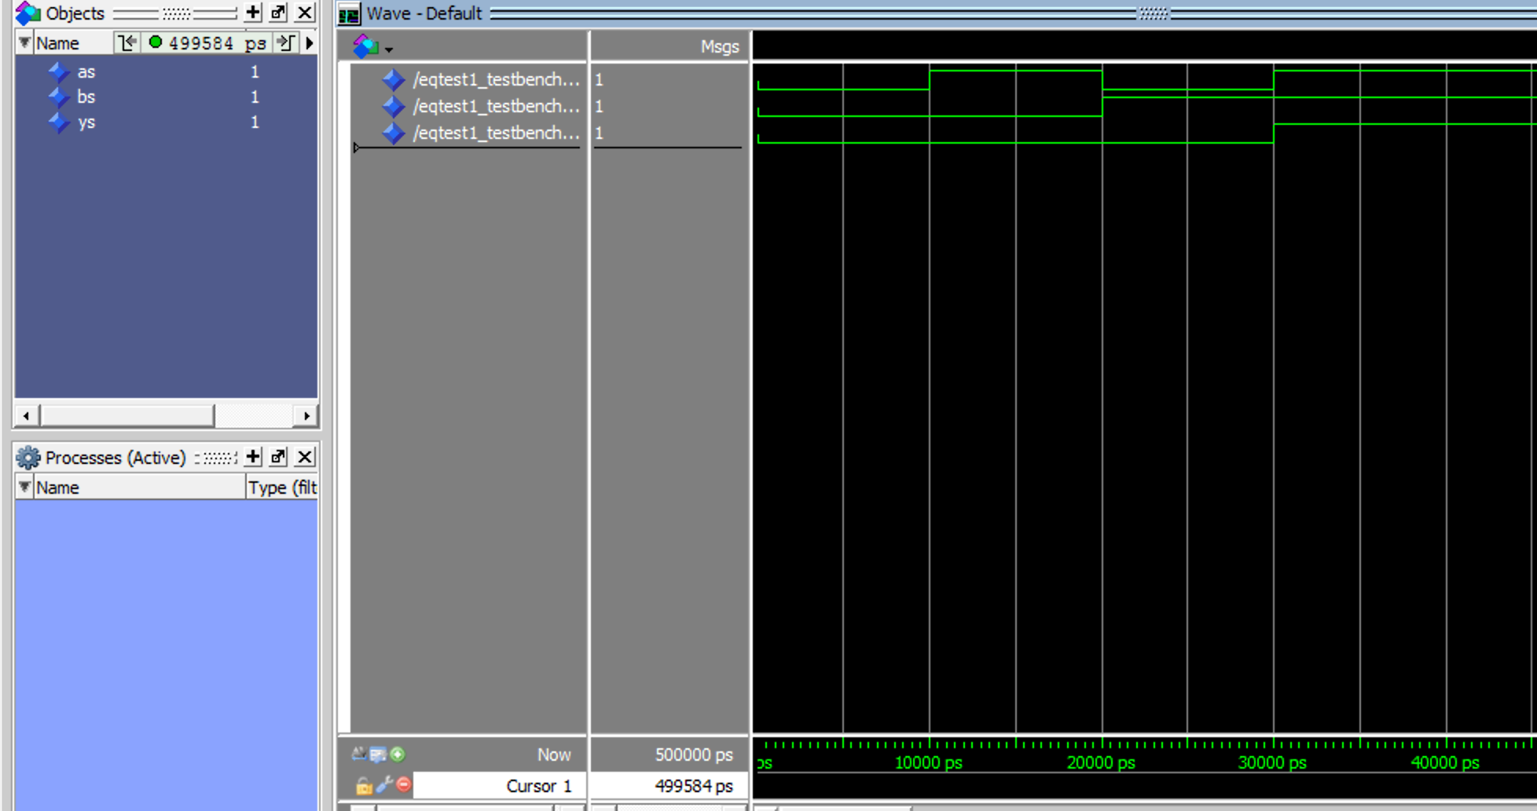
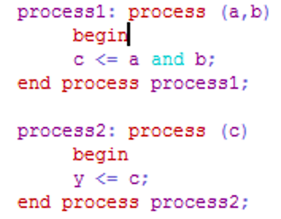
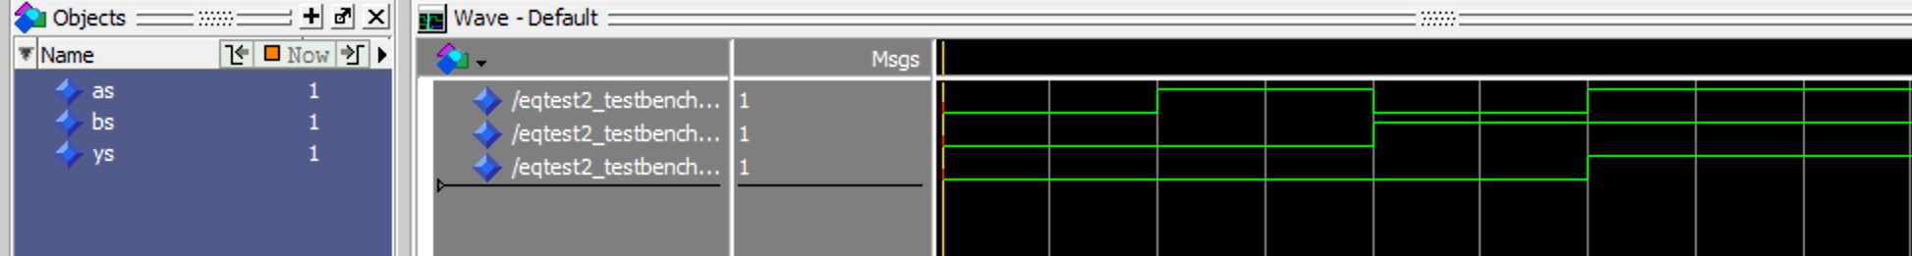

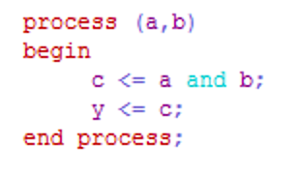
Practical 5b- VHDL Testbench
EqTest1.vhd
a
b
y
EqTest2.vhd
a
b
y
a
b
y
EqTest3.vhd
24

